Slide 1

Rectangle Recognition with AI
From,
Shubham Jain
Northeastern University
jain.shub@northeastern.edu
Ph# +18572779279

Slide 2
Approach Considered
Understand about Image processing and libraries available.
Considered OpenCV.js libraries to perform shape detection.
Considered Javascript language for the ease of browser display and debug.
Used documentation of OpenCV to identify methods and attributes to be used.
Used IntelliJ and Google Chrome to display results, debug and test.

Slide 3
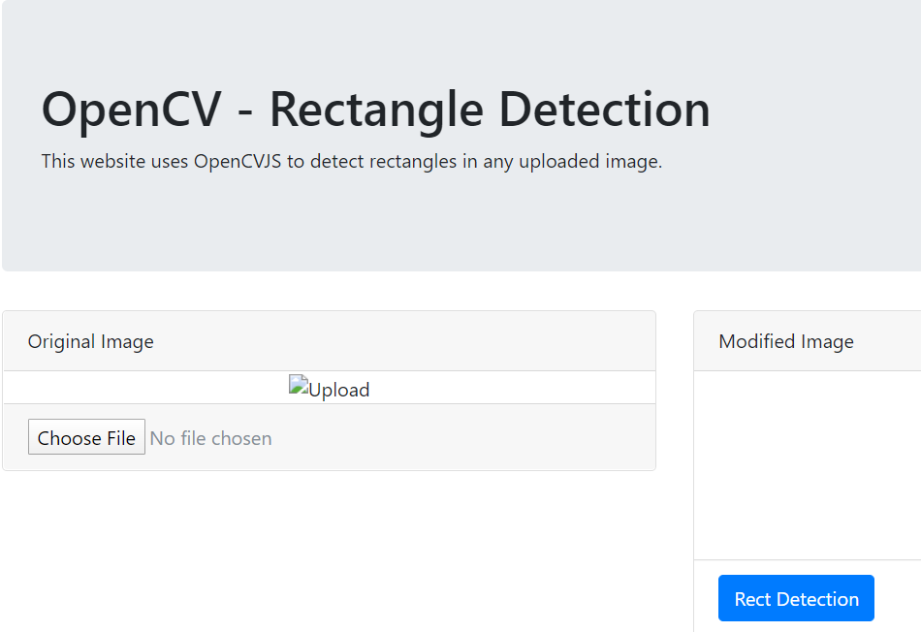
Procedure
Wrote HTML page using predefined CSS.
Wrote JS script to perform functions on load of page and on change of image.

Slide 4
Image load using imread of Opencv
Applied cloning into new matrix to work on.
Performed grayscaling to convert colors in black and white only.
Performed threshold to sharpen the colors to proper black and white (used binary)
Performed bitwise_not to invert color to get white lines.
Performed dilation to transform morphologically the image to thicken the white lines to fill gaps.
Performed erosion to transform morphologically the image to remove small gaps.
Used findContours to find all the contours in the image.
Used boundingRect to bind each contour in rectangle to find approximated corners.
Calculated x and y of each point of each rectangle.
Added circle to all the corner points
Applied text to each point.

Slide 5
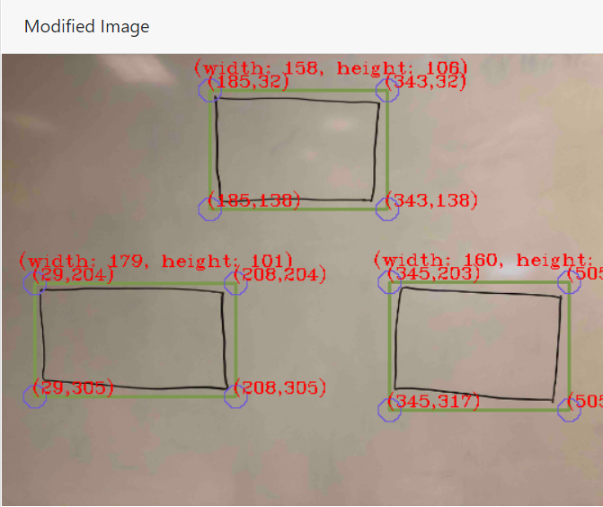
Output

Slide 6

Trial and Error
Hough Lines and Intersection
Challenge: Complex Implementation, Hough Transformation Algorithms
Extracting points for contours instead of boundingRect
Challenge: All contours rows returned including image contours. Difficult to extract corner values
Used drawContours over the contours trying to fix above problem
Fix not worked.
BoundingRect worked for the approximation, but not exact results acquired.

Slide 7


Possibility of Correction and enhancements
Can use better morphological transformations to provide good contours.
Can use NonMaxSupression to avoid multiple contours.
Need to learn more about tensorflow which allow similar methods
tf.image.non_max_suppression (python)
tf.image.draw_bounding_boxes (python)
Learn about training models to test with rectangles, rotated rectangle and other possibility of this shape.

